Slide 1
Secom Data Set
Classification Report
Group member ：ZHOU Bin YU Shilong ZHANG Liangshan HU Fuqin
Pleader ：ZYZH Date ：2018.08.29

Slide 2
1
2
3
4
5
6
Problem
description
Data
preprocessing
Data
balancing
Dimension
reduction
Optimization
and classification
algorithm
Conclusion and
summary
CONTENTS

Slide 3
Part One
Problem
description

Slide 4
Problem description
Object
Secom data set
  To determine whether the wafer is qualified according to the test data of the wafer collected by multiple real-time sensors
Two classes
590 features
1567 samples
104 samples for defective products
1,463 samples for normal products
Ratio of two classes 14:1 (pass: fail)
  NAN and other invalid value within
Final requirement
Inspection accuracy of defective product should be at least 72%
Essential problem: two-class and imbalanced classification problem with massive samples and excessive features
*

Slide 5
Steps and methods
Data preprocessing
Solving the
imbalanced problem
Intelligent algorithm and classifier selection
Feature selection
*

Slide 6
Part Two
Data
preprocessing

Slide 7
normalization
Simple scaling
Standard deviation
standardization
Nonlinear normalization
min-max standardization()
x = (x - u)/σ
log、Exponential, Tangent, etc
This normalization method is applicable to the case where the values are concentrated.If Max and min are unstable, it is easy to make the normalization result unstable
In classification and clustering algorithms, the second method (z-score standardization) performs better when distance is used to measure similarity, or when PCA is used to reduce dimension.
It is often used in scenarios where the data is highly differentiated, some of the values are large and some of them are small.The calculation is too large.
*

Slide 8


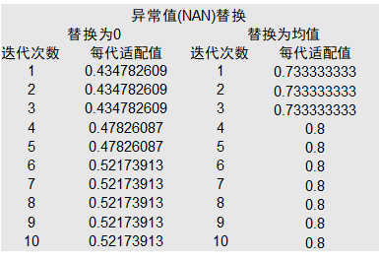
Deletion processing
Mean replacement
Too many missing samples
Not recommended
Exception handling? (out)
*

Slide 9
Partition data set
Set aside method
Divide a training set and a test set
Leave one and leave P
Cross validation
SMOTE
Cross validation is required
The training set needs to be balanced
The test set is not required
folding method
The two need cross validation after cross validation
Divide K data sets for cross validation
*

Slide 10
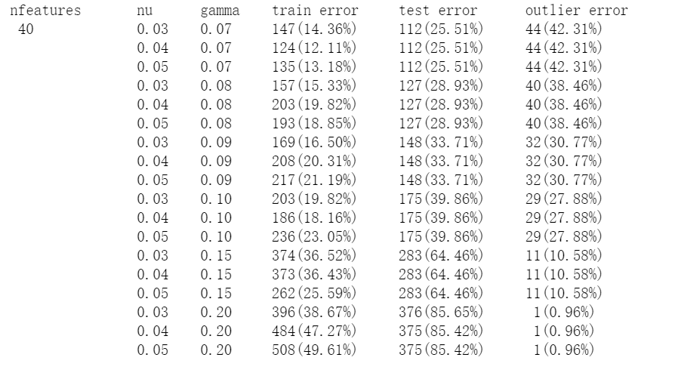
One class SVM
https://github.com/Meena-Mani/SECOM_class_imbalance/blob/master/secomdata_ocsvm.ipynb
Shall not be used
*

Slide 11
Part Three
Equilibration

Slide 12







Balance method
Balance method
Undersampling
Oversampling
Integrated sampling
SMOTE
ADASYN
SMOTEENN
*

Slide 13
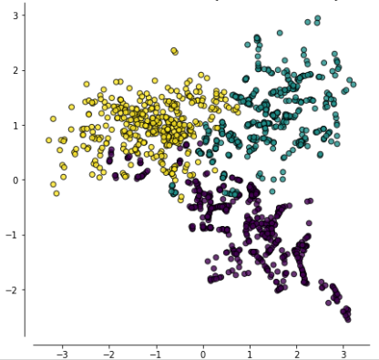
Class imbalance
The new minority samples are synthesized in a specific way so that the two categories in the training set are roughly equal in number.
SMOTE
Generate different numbers of new samples for different niche samples based on data distribution.
ADASYN
A new minority sample is synthesized by SMOTE, and then the noise generated during the SMOTE process is cleaned by ENN.
SMOTEENN
*

Slide 14
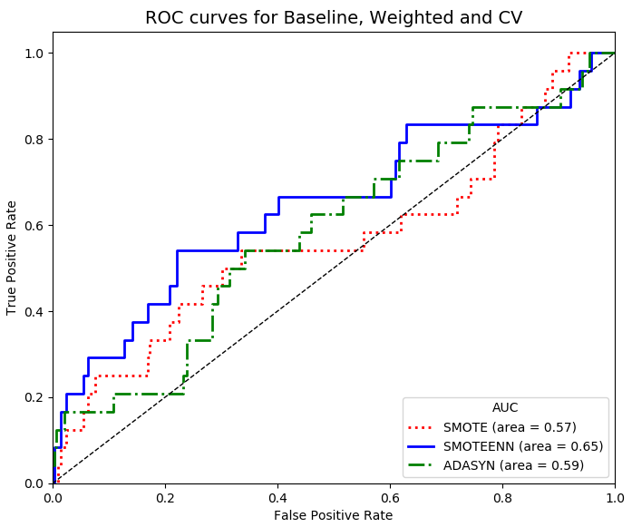
Comparison of three methods of class imbalance
Overall SMOTEEN is better
*

Slide 15
Part Four
Feature selection
and dimension
reduction

Slide 16

Feature selection
Purpose: To speed up training, lower model complexity and better interpretability, higher accuracy (selected features), and reduced overfitting.
Recursive feature elimination
A base model (SVC / LR) is used to perform multiple rounds of training. After each round of training, the characteristics of several weight coefficients are eliminated, and the next round of training is performed based on the new feature set.
Mutual information
Mutual information measures the degree of interdependence between two variables, indicating that the content of information shared between two variables is not limited to a linear relationship.
*

Slide 17
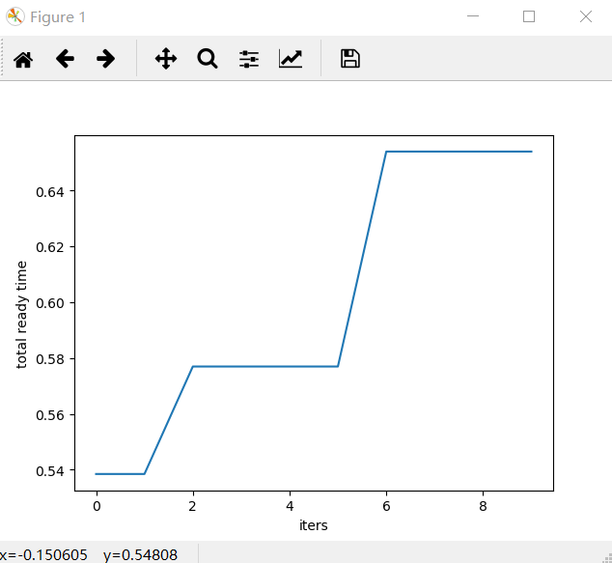
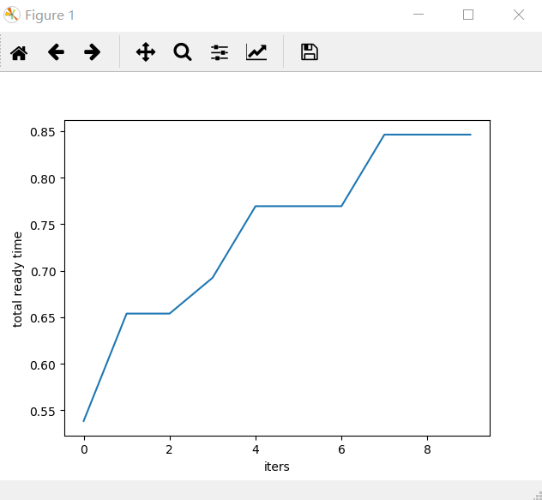
Recursive feature elimination method
vs mutual information
mutual information
recursive feature elimination
*

Slide 18
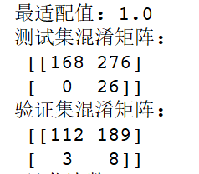
Dimensionality reduction
Mapping from high dimensional feature space
to low latitude feature space
Advantages of PCA:
1. Minimum error.
2. extracted the main information
Disadvantages of PCA:
1. The principal component with small contribution rate may often contain important information about sample differences.
2. over-fitting is serious
Using 200 feature PCA to reduce dimensionality
Not used!
*

Slide 19
Part Five
Intelligent
algorithm
and classifier

Slide 20
Intelligent algorithm selection（GA）
01
Number of iterations, population size, crossover probability, mutation probability, gene length
Define
hyperparameters
Fitness function
In this problem, the training set training model, the test set through the model to obtain the recall rate, the greater the recall rate represents the better classification effect, so the recall rate as a fitness function.
02
Initial
population
The coding method adopts 01 coding, and the genetic sequence (feature selection) of each individual is randomly arranged.
03
Survival of
the fittest
The recall rate (also called the recall rate) is the ratio of the number of related documents retrieved to the number of related documents in the document library.
In this question, the ratio of the predicted positive samples to the total positive samples
Choosing the appropriate fitness function, using the tournament operator to select the parent, cross mutation to produce the child
04
Genetic
Variation
*

Slide 21
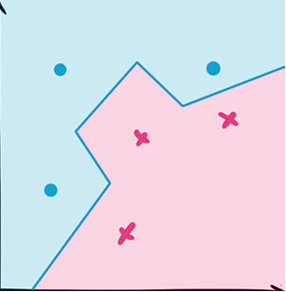
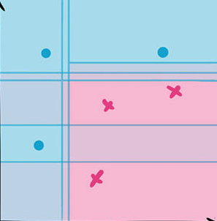
Classifier
For the point to be judged, find the data points closest to it, and determine the type of the point to be judged according to their type.
KNN
Randomly select different features and training samples, generate a large number of decision trees, and then combine the results of these decision trees to perform the final classification.
Rf
Core idea: three stinkers, top one Zhu ge Liang
The weak classifiers are combined according to a certain calculation method to form a strong classifier. There is an association between the classifiers. The final classification is the result of multiple classifier combinations.
AdaBoost
*

Slide 22
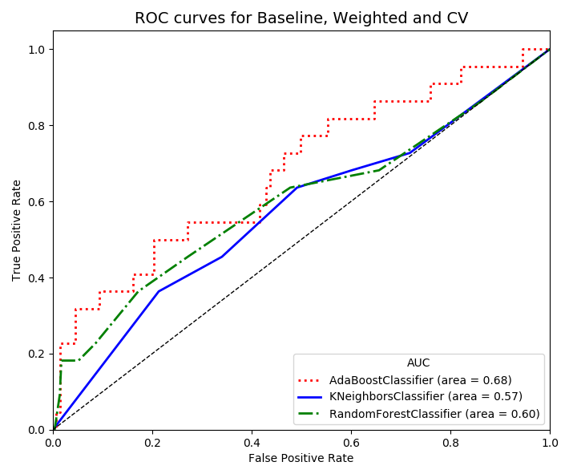
Comparison of three classifiers
With FPR as the horizontal axis and TPR as the vertical axis, the ROC space is obtained. The AUC value is the area covered by the ROC curve. The larger the AUC value, the better the classifier classification effect.
*

Slide 23
Part Six
Conclusion and
summary

Slide 24
Flow chart
Feature selection and dimensionality reduction
Data preprocessing
Data balance
Intelligent algorithm and classifier
Read data
Training set SOMTENN
Variance feature elimination
Integrated classifier classification （adaboost）
Standard deviation standardization
Recursive feature elimination method to 100
GA algorithm selection subset
Mean fill data
Leave one method to divide the data set
*

Slide 25
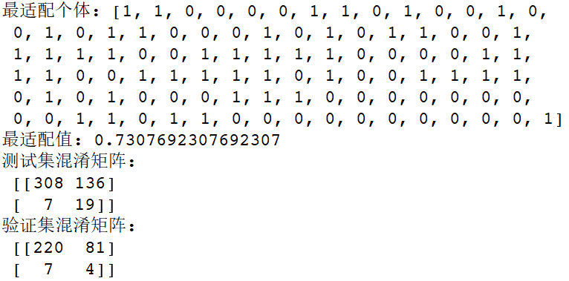
Conclusion
Meet the requirements
*

Slide 26
Summarize
HU Fuqin：Data preprocessing
ZHOU Bin： Balanced
YU Shilong：Pre-screening
ZHANG Liangshan：Genetic algorithm
division of work
1) Team level: the division of labor is not clear, resulting in duplication of labor;
2) Personal level: poor ability to write code;
3) Project level: the model hyperparameter tuning is not enough, the degree of visualization is poor, and the data analysis is not enough.
inadequate
*

Slide 27
Thanks for listening
will request earnestly fellow teachers to give the criticism to point out mistakes！
Mentor ：Lord Bao Pleader ：ZYZH

